Slide 1
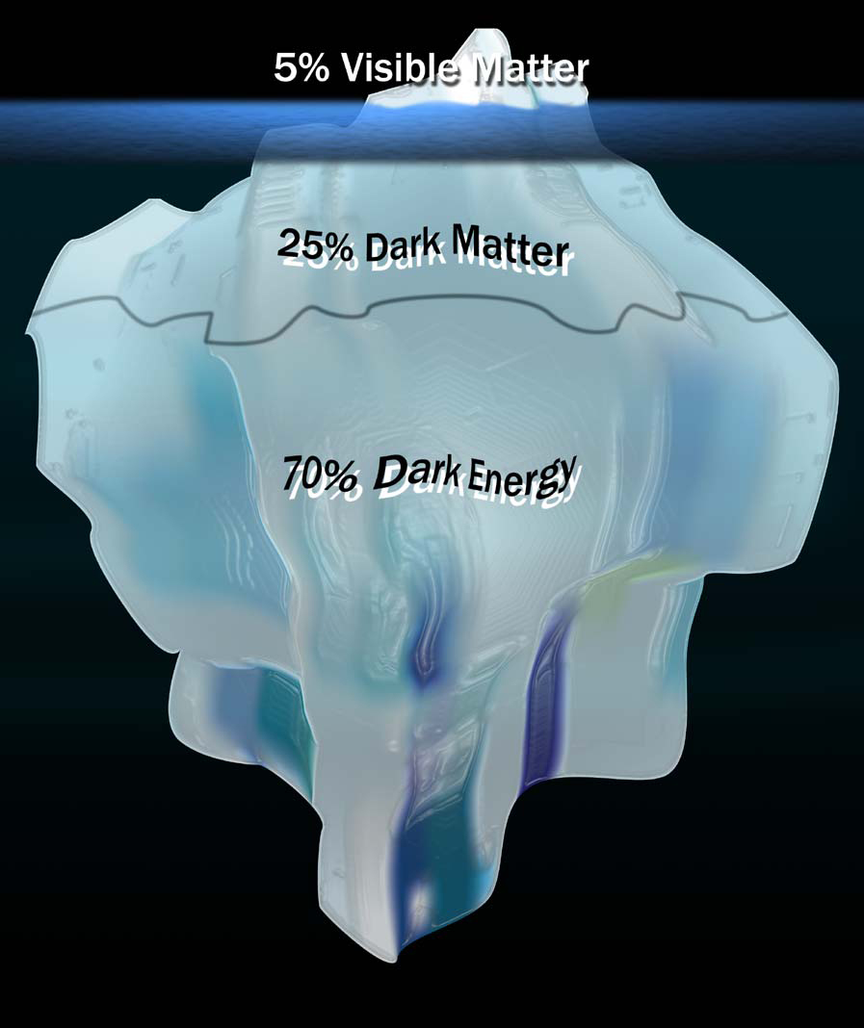
Searching for the rest of the Universe: Dark Matter
Brian W. Mulligan
Astronomy on Tap ATX
20 Sept 2016

Slide 2
What is dark matter?
Answer:
?
?
?
?

Slide 3
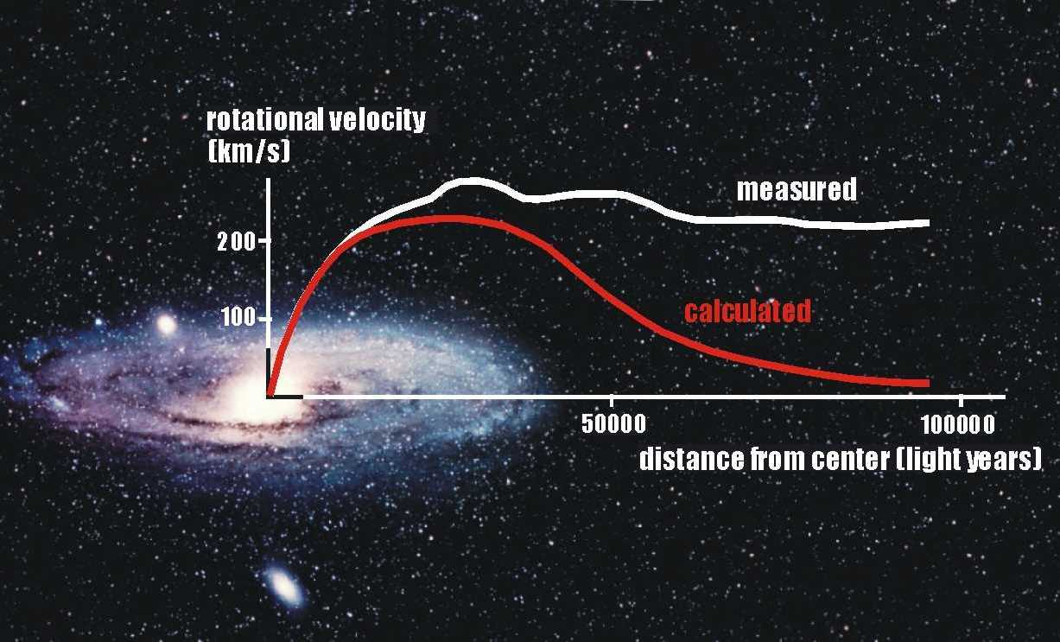
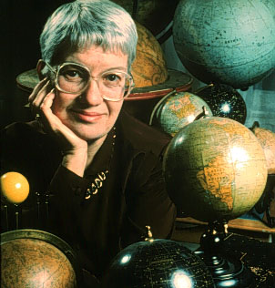
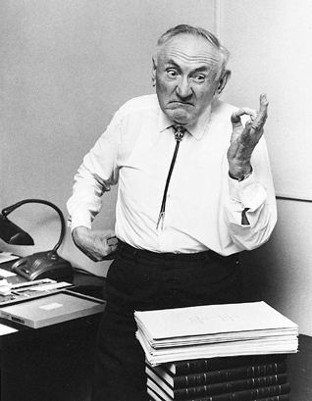
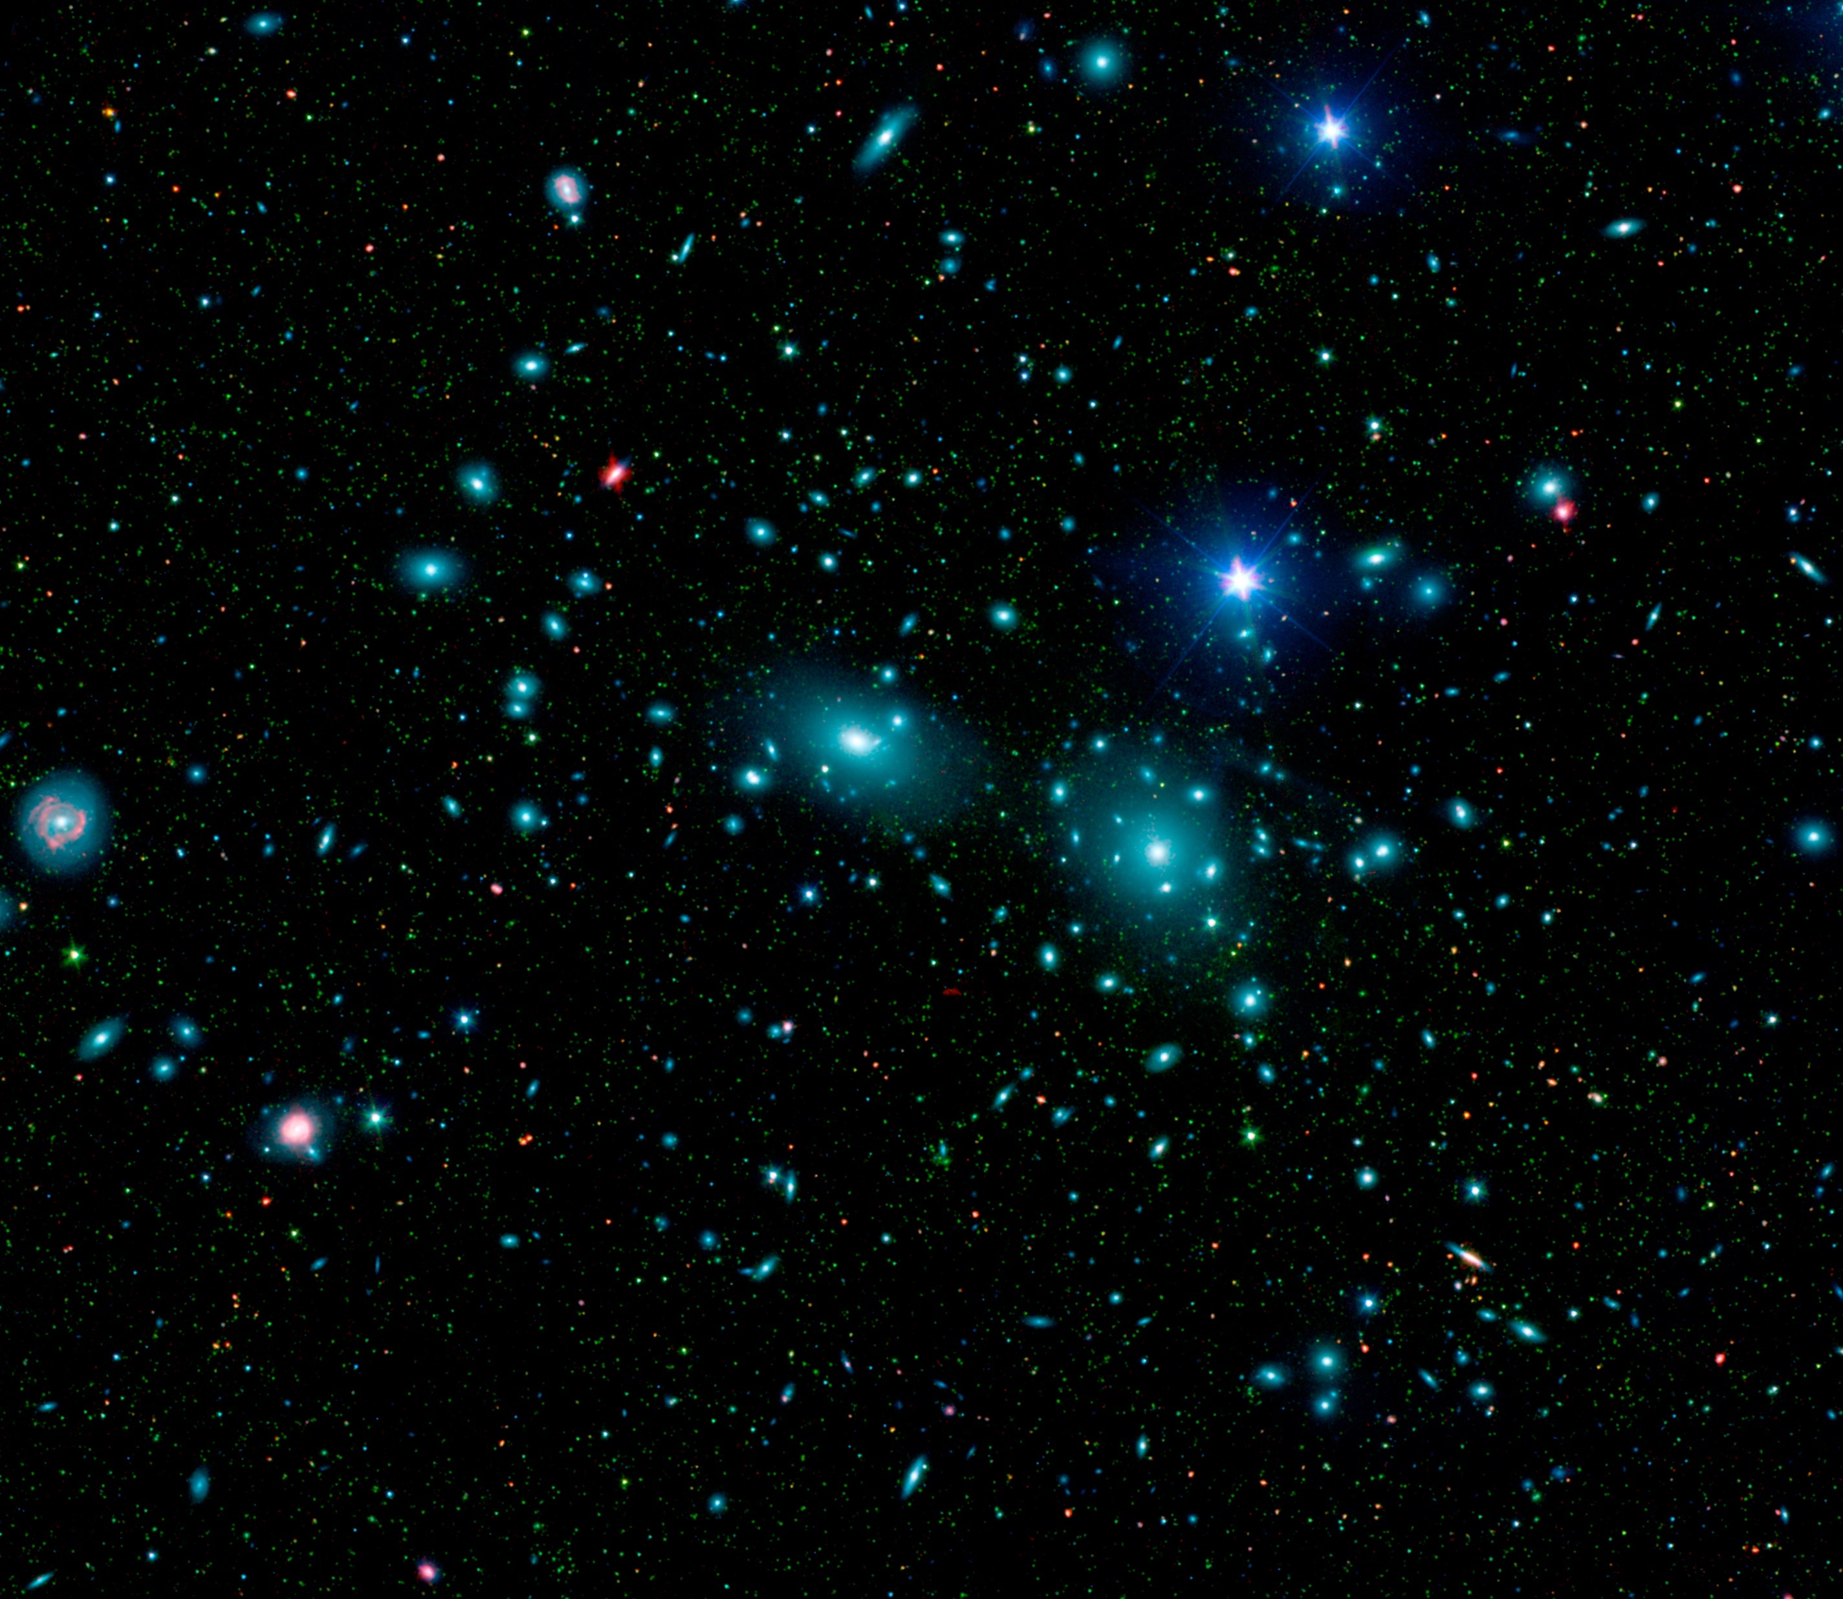
Dark Matter’s Gravitational Effects
dark = doesn’t interact with light
(except via gravity)

Slide 4
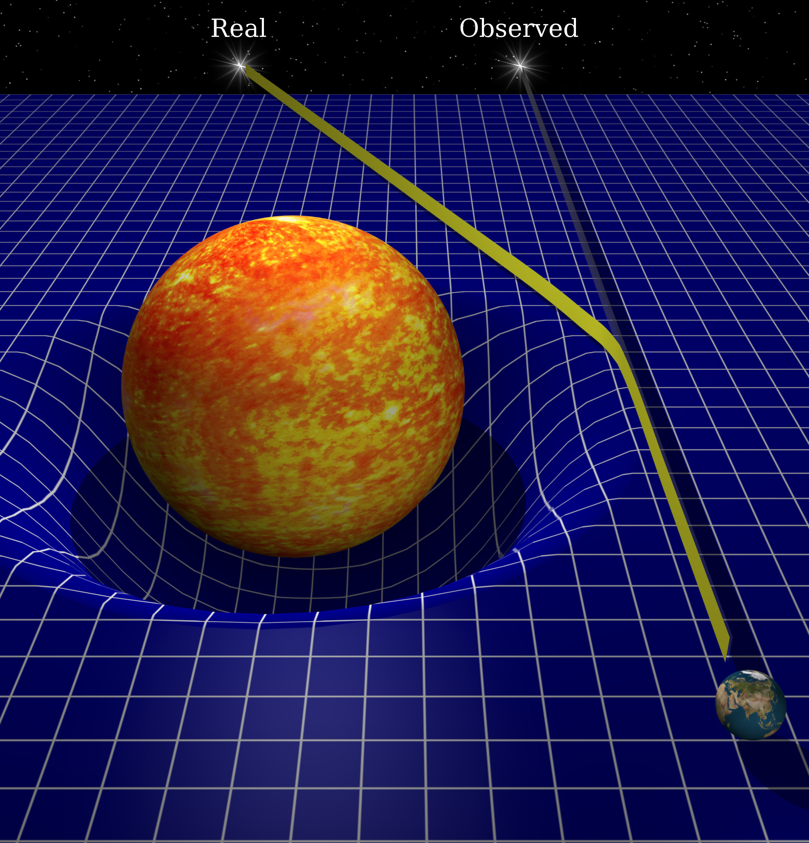
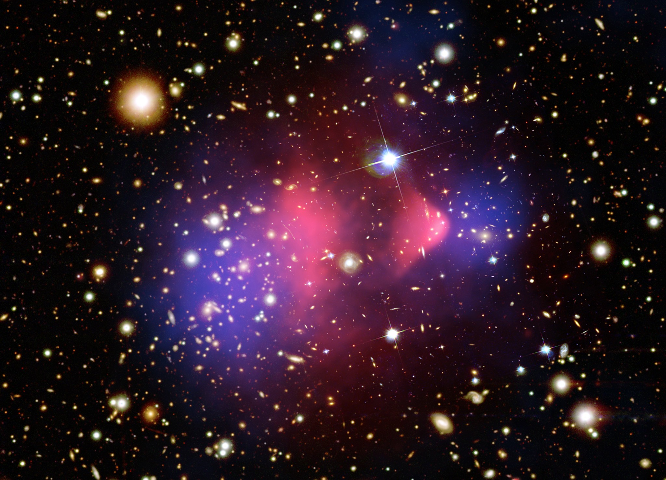
Lensing & the Bullet Cluster
Blue = Gravitating Mass
Red = Hot Gas

Slide 5
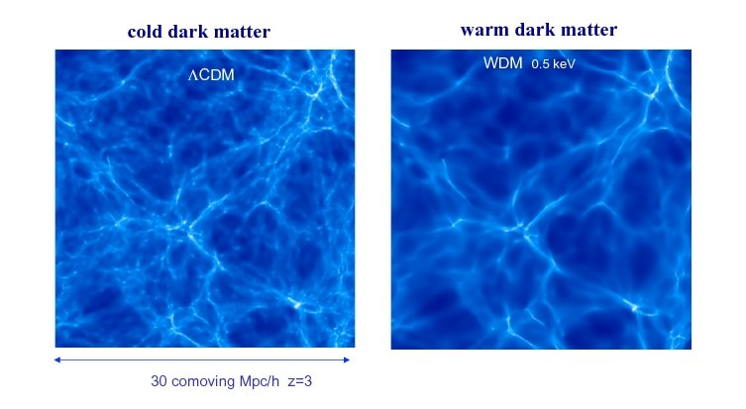
Cosmological Simulations
cold (or warm)
=
DM moves slowly
=
very massive particles
Bright = Lots of Galaxies

Slide 6
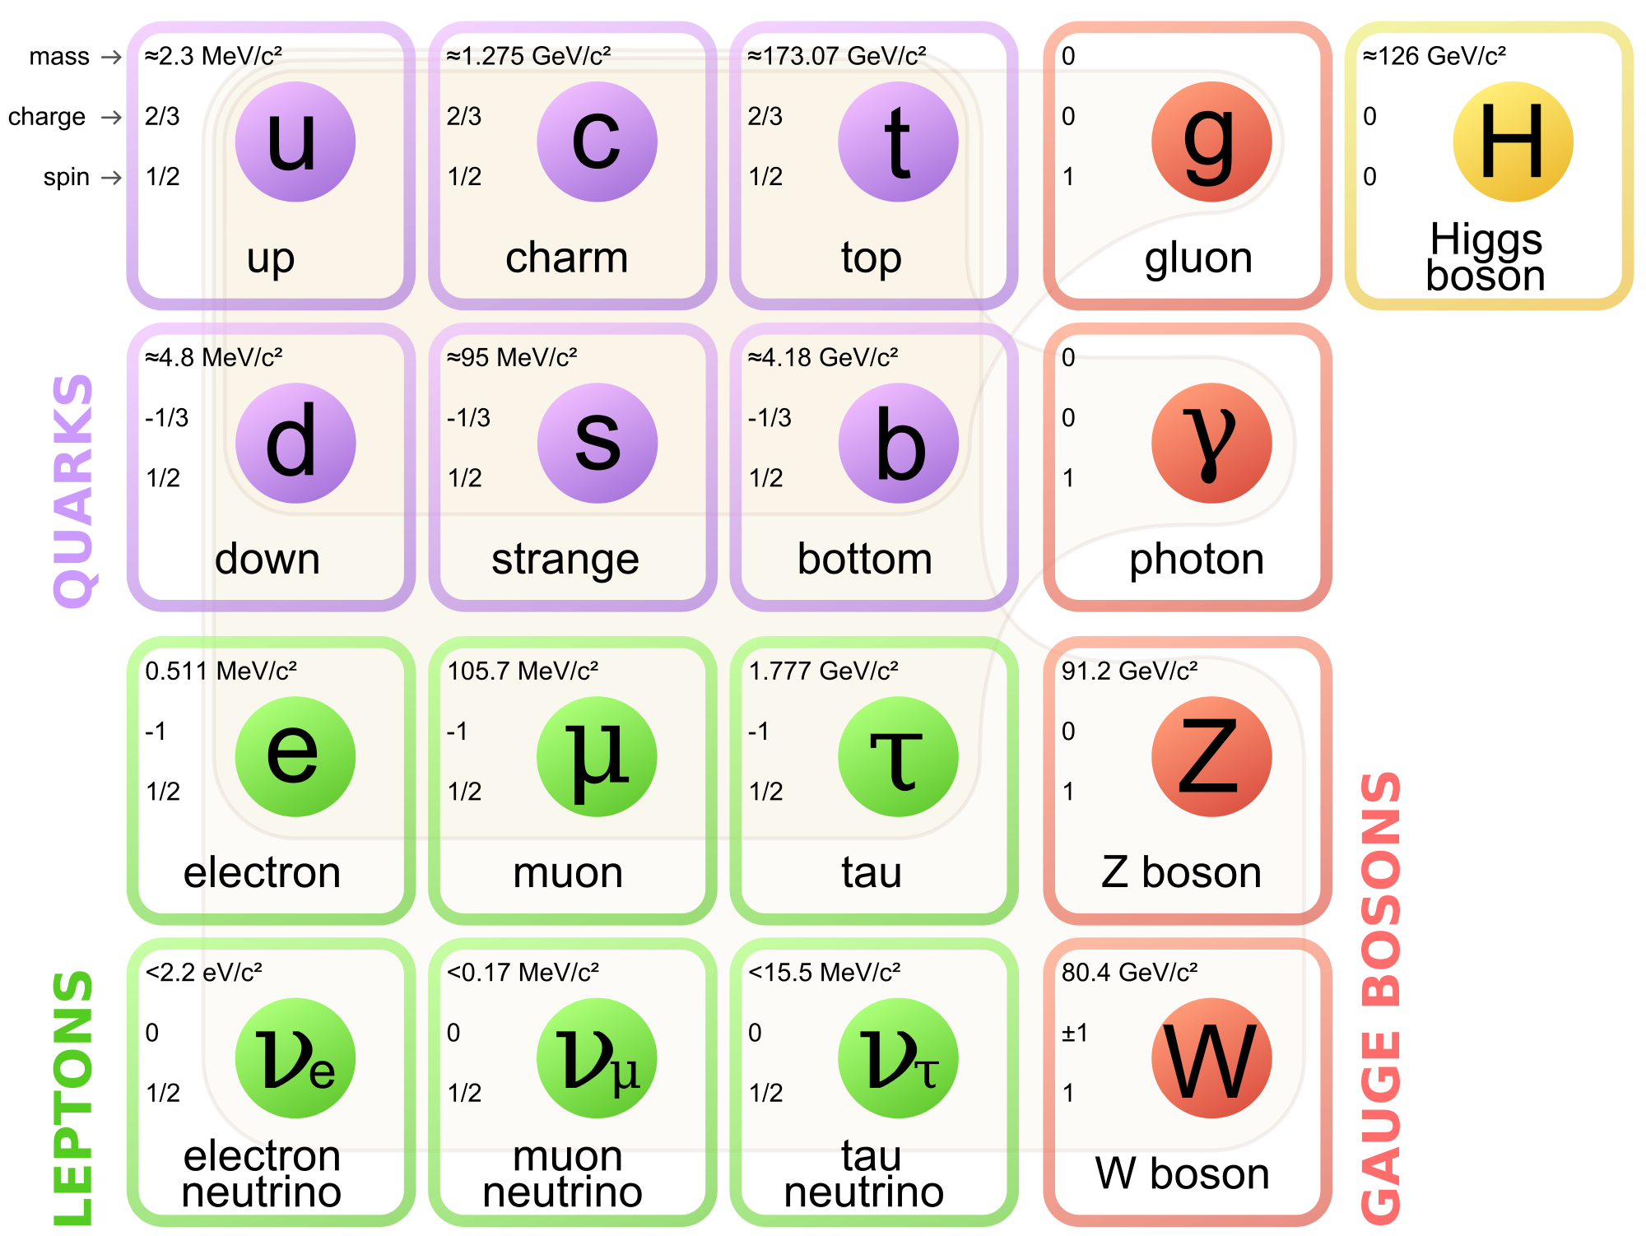
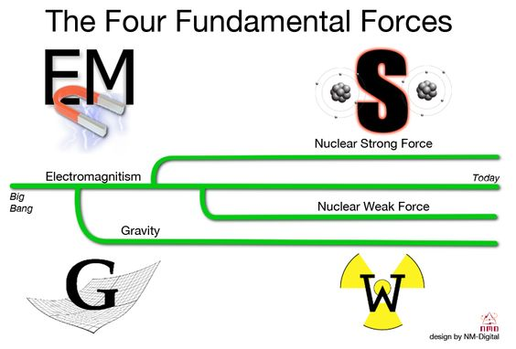
Forces & Particles
Most Normal Matter (atoms)
G
Graviton

Slide 7
Interactions for Dark Matter
?
?
?
DM
DM?
DM?

Slide 8
Strong Force
u
d
u
u
u
u
d
u
u
u

Slide 9


Weak Force
u
u
d
d
d
u
$${\text{e} }^{−}$$
$${\text{ν} }^{0}$$

Slide 10
Direct Detection Experiments
LUX
CDMS
DM
Fancy
Electronics
Germanium Crystal
Xenon Gas
Heat
Superconductor
Light
Light Detectors

Slide 11
Direct Search Results
Maybe?
NOPE!
(Experiments)
Dark Matter Particle Size (cm^2)
NOPE!
(neutrinos)
Maybe?

Slide 12
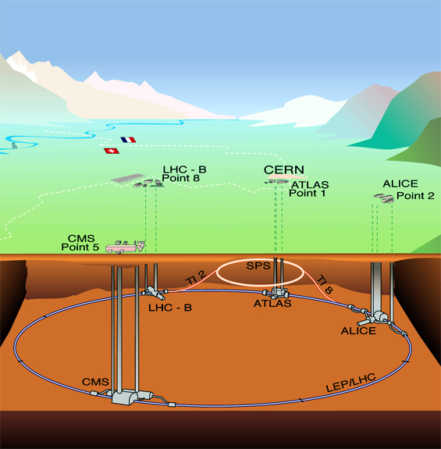
Making Dark Matter
DM

Slide 13

Indirect Search Results

Slide 14
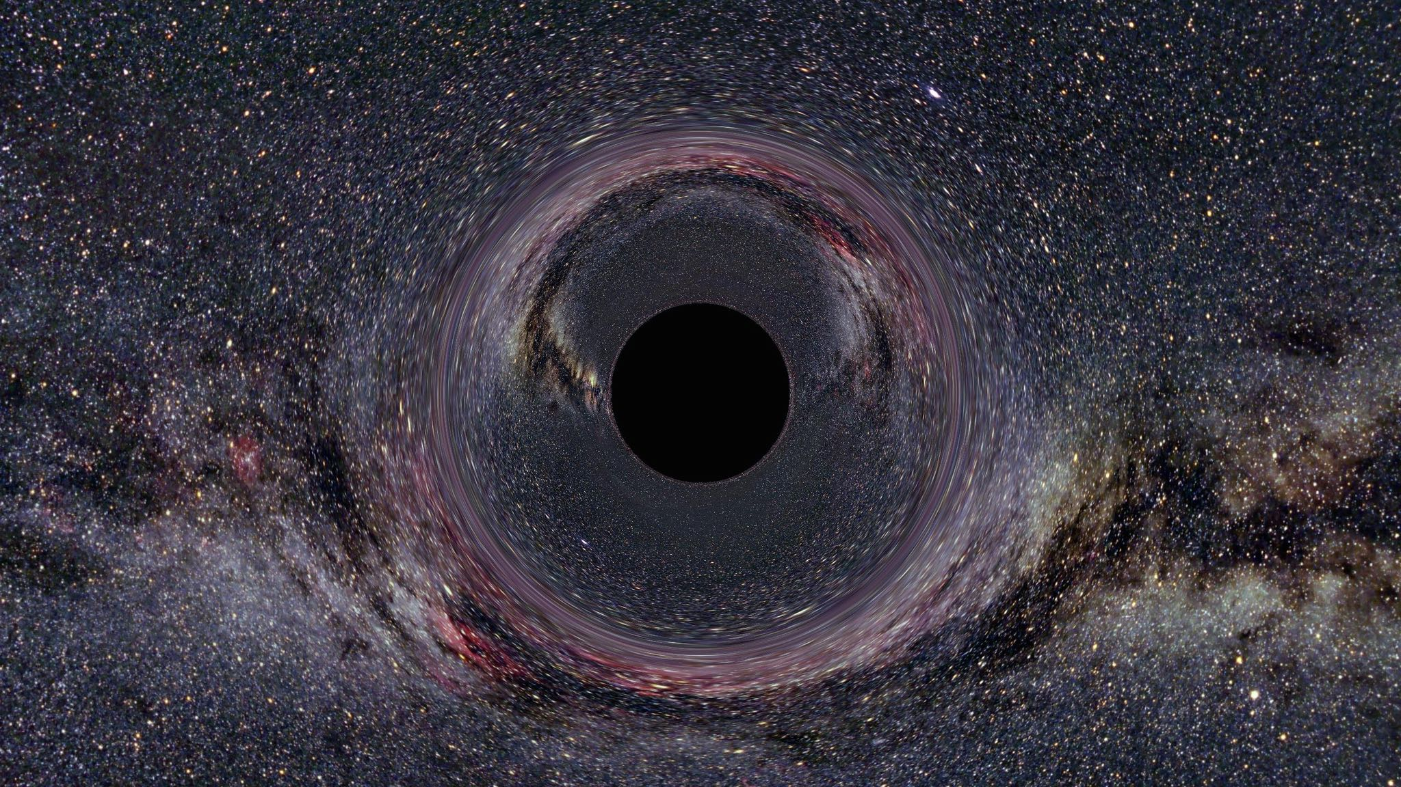
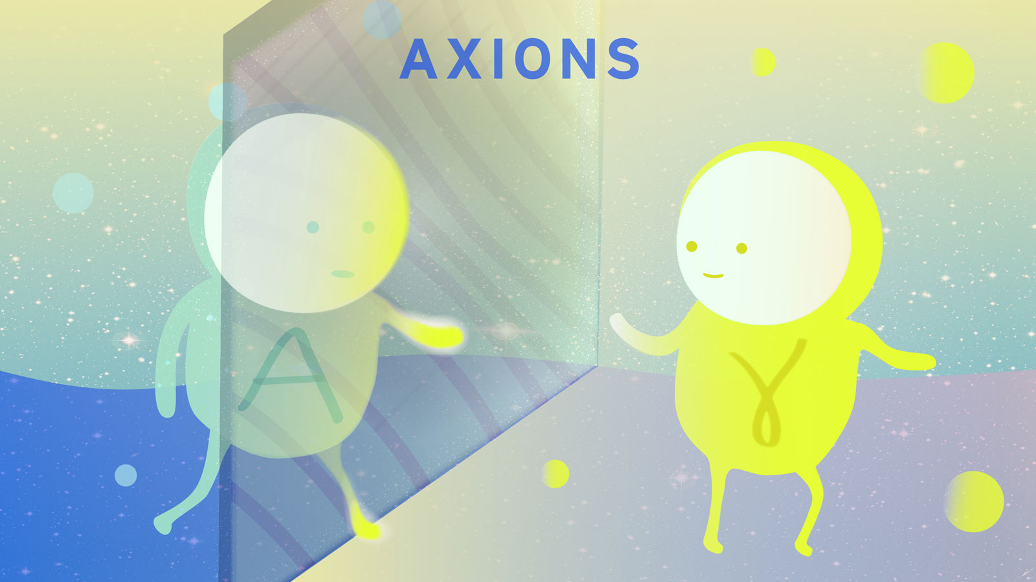
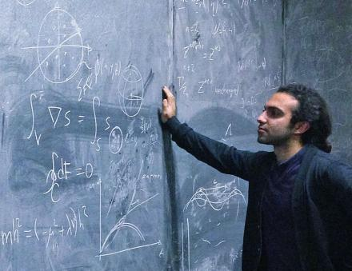


Other possibilities?

Slide 15
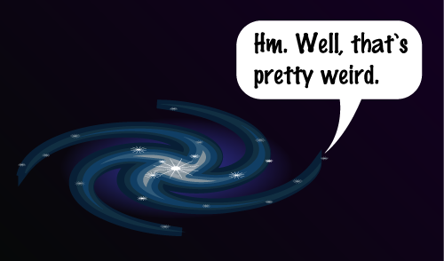
Stay Tuned!

